Slide 1
C# and SQL Concurrency

Slide 2
C# Signaling Mechanisms
Coordinate Threads, Prevent Chaos
Monitor.Wait/Pulse: Mutual exclusion and notification (via lock keyword).
AutoResetEvent: Releases one waiting thread, then auto-resets.
ManualResetEvent: Releases all waiting threads, requires manual reset.
Notes:
As soon as you type new Thread(), it’s over; your project already has legacy code.

Slide 3
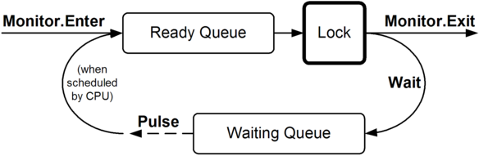
C# Signaling Mechanisms

Slide 4
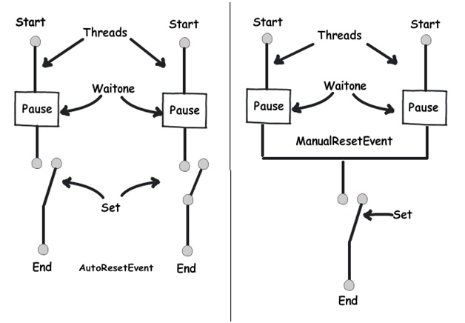

Slide 5
Channels - Modern Message Passing
Decouple & Stream Data Asynchronously
System.Threading.Channels: Asynchronous, thread-safe producer-consumer queues.
Decoupling: Producers and consumers don't share direct state.
Async-Friendly: Built for async/await patterns.
Bounded/Unbounded: Control capacity and flow.

Slide 6
Channels - Modern Message Passing
var tasks = transactions.Select(t => Task.Run(() => ProcessTransaction(t))); await Task.WhenAll(tasks); // Result: Memory explosion, thread pool starvation
var channel = Channel.CreateBounded<Transaction>(1000);
var workers = Enumerable.Range(0, Environment.ProcessorCount).Select(_ =>
Task.Run(async () => {
await foreach (var transaction in channel.Reader.ReadAllAsync())
await ProcessTransaction(transaction); }));
foreach (var transaction in transactions)
await channel.Writer.WriteAsync(transaction);
Notes:
One-time operations
CPU-bound work where you want maximum parallelism
Fire-and-forget scenarios

Slide 7
C# Concurrency: Shared Memory vs. Channels
Feature | Shared Memory (e.g., lock, Monitor) | Message Passing (e.g., Channels)
Concept | Threads directly access shared data | Threads communicate via messages
Complexity | High (race conditions, deadlocks) | Lower (decoupled, safer)
Performance | Potentially faster (no data copy) | Overhead for data copying
Best For | Fine-grained control, large data, within process | Decoupling, async, producer-consumer

Slide 8
Semaphore - Limiting Access
Limit Concurrent Access to Resources
Semaphore: System-wide (cross-process) semaphore.
SemaphoreSlim: Lighter, in-process semaphore (supports async).
Use Cases:
Database connection pooling.
Limiting concurrent calls to external APIs.
Controlling access to a fixed number of resources.

Slide 9
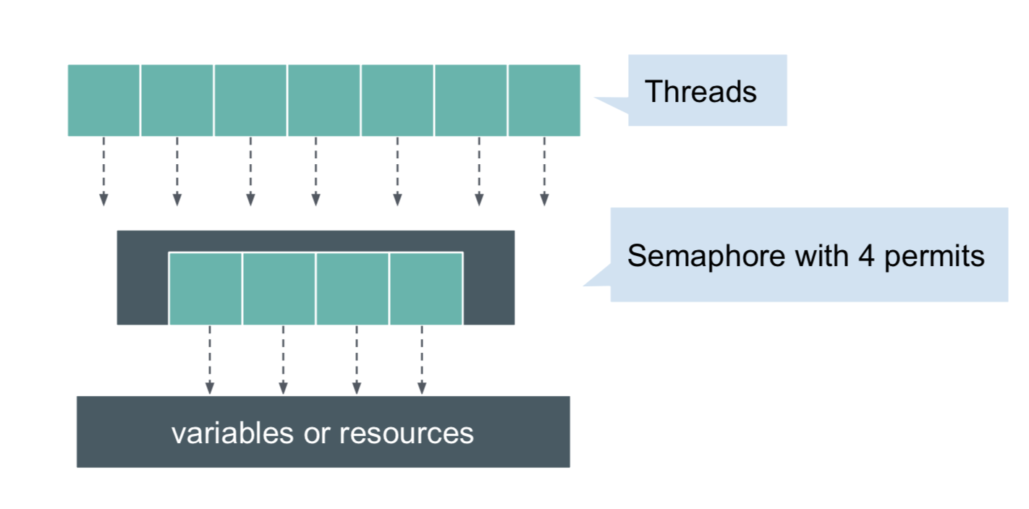
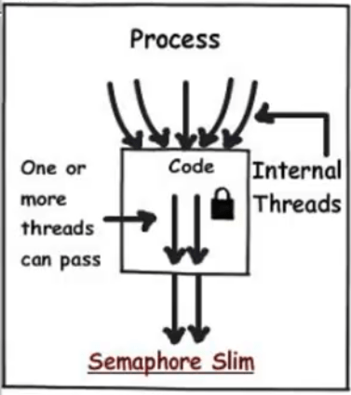

Slide 10
SQL Transaction Isolation
Isolation Levels:
ReadUncommitted
Read Committed
Repeatable Read
Serializable
ACID Properties
Atomicity
Consistency
Isolation
Durability

Slide 11
Read Phenomena
-- Dirty Read
T1: UPDATE Account SET Balance = 100
T2: SELECT Balance -- Sees 100
T1: ROLLBACK -- Oops!
-- Non-Repeatable Read
T1: SELECT Balance -- 50
T2: UPDATE Balance = 100
T1: SELECT Balance -- 100 (different!)
-- Phantom Read
T1: SELECT COUNT(*) WHERE Age > 25 -- 10
T2: INSERT Person (Age = 30)
T1: SELECT COUNT(*) WHERE Age > 25 -- 11
Lock Types:
- S - Shared (SELECT)
- X- Exclusive (UPDATE/DELETE)
- U - Update (SELECT FORUPDATE)
- I* - Intent (IS, IX, IU)

Slide 12
Thank you!

